Slide 1
    LIFERAY DXP
    Content Management
Nov 2022

Slide 2
    TRAINING PLAN INTRODUCTION
Nov 2022

Slide 3
Session Blocks
Recommended : 1 hour sessions (3 or 4 to be planned)
This training plan is focused essentially on updating or creating content.
Some essential admin and site management principles are also introduced to give a broader context
1°) Introduction
How to start
How to access the web site(s) I can administrate
How to toggle from one web site to another
How to search for a web site in the list
2°) Site administration – Main menu (left part of the screen)
Site builder / pages (same as Pages Administration)
How to copy a page
Content and data / Web content components, history and edition
People / How to administrate users, memberships and roles (permissions)
Configuration / How to activate/disactivate a web site
Configuration / How to set a language
3°) Site administration – Tree view (left part of the screen)
How to create a page and position it in the tree view
How to configure a page (name and url)
How to create a child page and why
How to manage page hierarchy (Pages Administration)
4°) Managing Site Content (middle and right part of the screen)
Storybook Web Site to understand components
Concept of Components versus Widgets
How to move components in a page
How to edit components in a page
How to add components (show both methods) or edit the footer
How to add or edit text
How to manage a Metaheader
How to manage a specific access button (Private Area)
How to incorporate and manage products and child pages
Tips and tricks
Sessions must be recorded by the local team, so it is hosted on their sharepoint
User Access to be provided before the sessions or after intro
To learn more, go to : https://learn.liferay.com/dxp/latest/en/index.html)

Slide 4
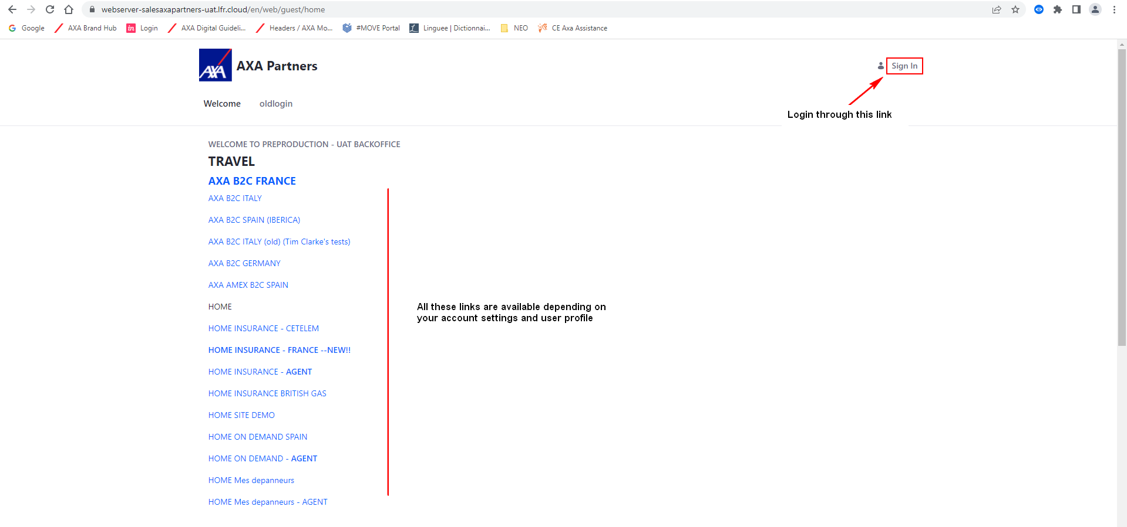
How to start
https://webserver-salesaxapartners-uat.lfr.cloud/fr/web/guest/home
Login : axa_partners_noprod
Password : PCLAUHm8qhtduCct9mi7msQGL
Test access in UAT :

Slide 5
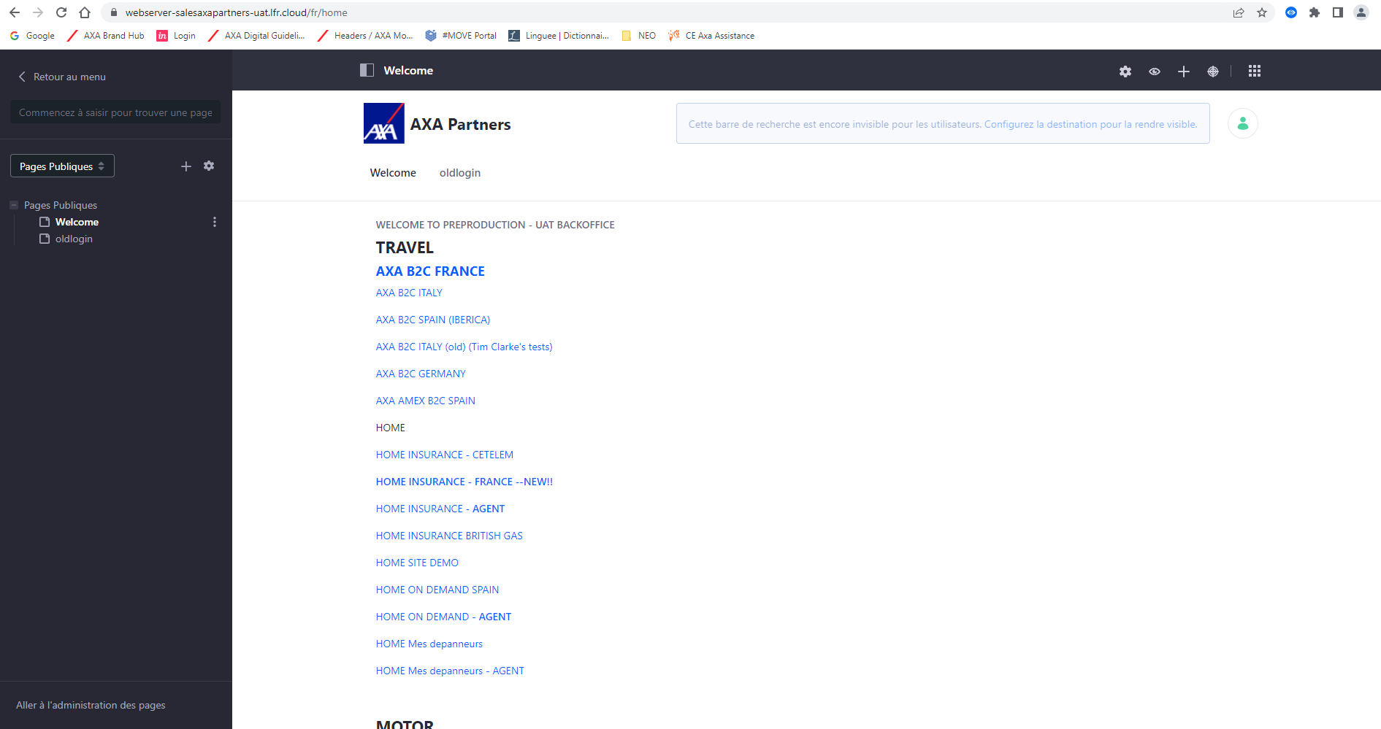
How to start
Once connected the Liferay Content Management Tool Home page is displayed

Slide 6
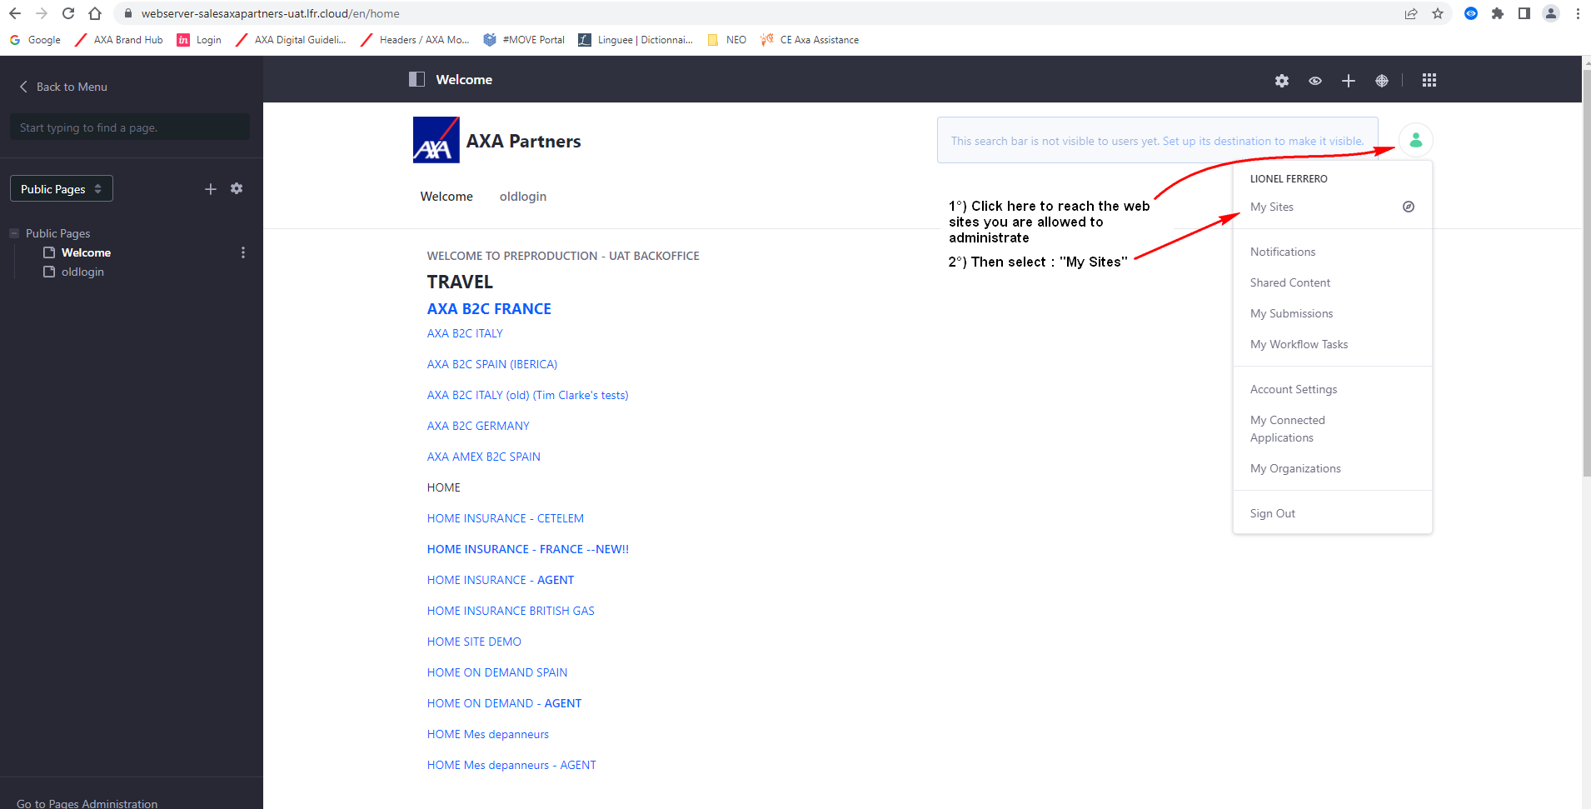
How to access the Web Sites I can administrate
Reach out for your sites

Slide 7
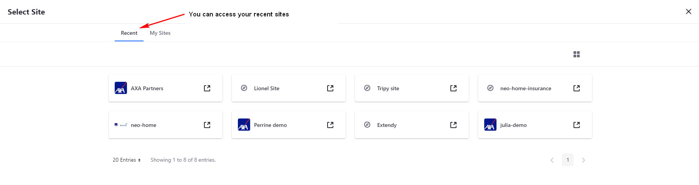
My Sites
Recent sites list

Slide 8
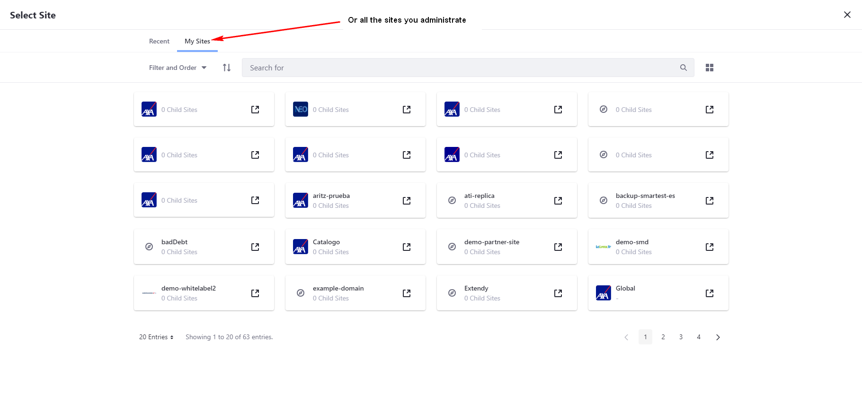
My Sites
All your sites list

